Slide 1

Torn-Image Reconstruction using Robust Registration and Seam-Aware Blending
This presentation details a fully automatic pipeline for reconstructing a single image from two torn parts, addressing challenges posed by unknown orientations, arbitrary tear edges, and varying image conditions.

Slide 2

Introduction: The Reconstruction Challenge
The Problem
Reassemble a single image from two torn parts, often captured by a phone camera.
Overcome significant photographic inconsistencies and damage.
Core Challenges
Unknown rotations (0/90/180/270 degrees) and flips/mirroring.
Arbitrary and irregular tear edges.
Low texture areas, such as lined paper.
Differences in perspective and lighting conditions between parts.
An example of torn document fragments exhibiting common challenges like rotation and lighting differences.

Slide 3


Our Approach: An Automatic Pipeline
Orientation
Registration
Exhaustive search for correct alignment.
Precise alignment of image features.
Stitching
Blending
Joining the reoriented and registered parts.
Seamless integration of the two halves.
Our goal is a fully automatic pipeline that performs orientation, registration, stitching, blending, and saves results while logging metadata in SQLite for comprehensive tracking.

Slide 4

Key Contributions to Robust Reconstruction
Exhaustive Orientation Search: Utilises edge compatibility scoring to find optimal alignment for heavily damaged or rotated fragments.
Hybrid Feature Registration: Employs SIFT/ORB + RANSAC homography for high-texture areas, falling back to edge-based alignment when features are sparse.
Seam-Aware Blending: Minimises visible seams using advanced blending techniques tailored for torn edges.
Automated Post-processing: Includes border cleanup and optional enhancement for a polished final output.
Metadata Logging: Comprehensive logging of reconstruction parameters and confidence scores in SQLite for analysis and reproducibility.
Visual representation of robust feature matching, critical for accurate image registration.

Slide 5
Literature Review: Foundations and Gaps
SIFT & ORB Features
FLANN/BFMatcher & Lowe's Ratio Test
RANSAC Homography
Robust keypoint detection and description (Lowe, 2004; Rublee et al., 2011).
Outlier-robust estimation of image transformations (Fischler & Bolles, 1981).
Efficient and reliable correspondence matching (Muja & Lowe, 2009).
Canny Edges & Strip Correlation
Multiresolution/Feather Blending
Structure matching along seams, particularly for low-texture content (Canny, 1986).
Seamless composite creation (Burt & Adelson, 1983).
Traditional panoramic stitching assumes significant overlap; our task involves complementary halves with minimal overlap and arbitrary orientations, requiring a novel combination of these established methods.

Slide 6
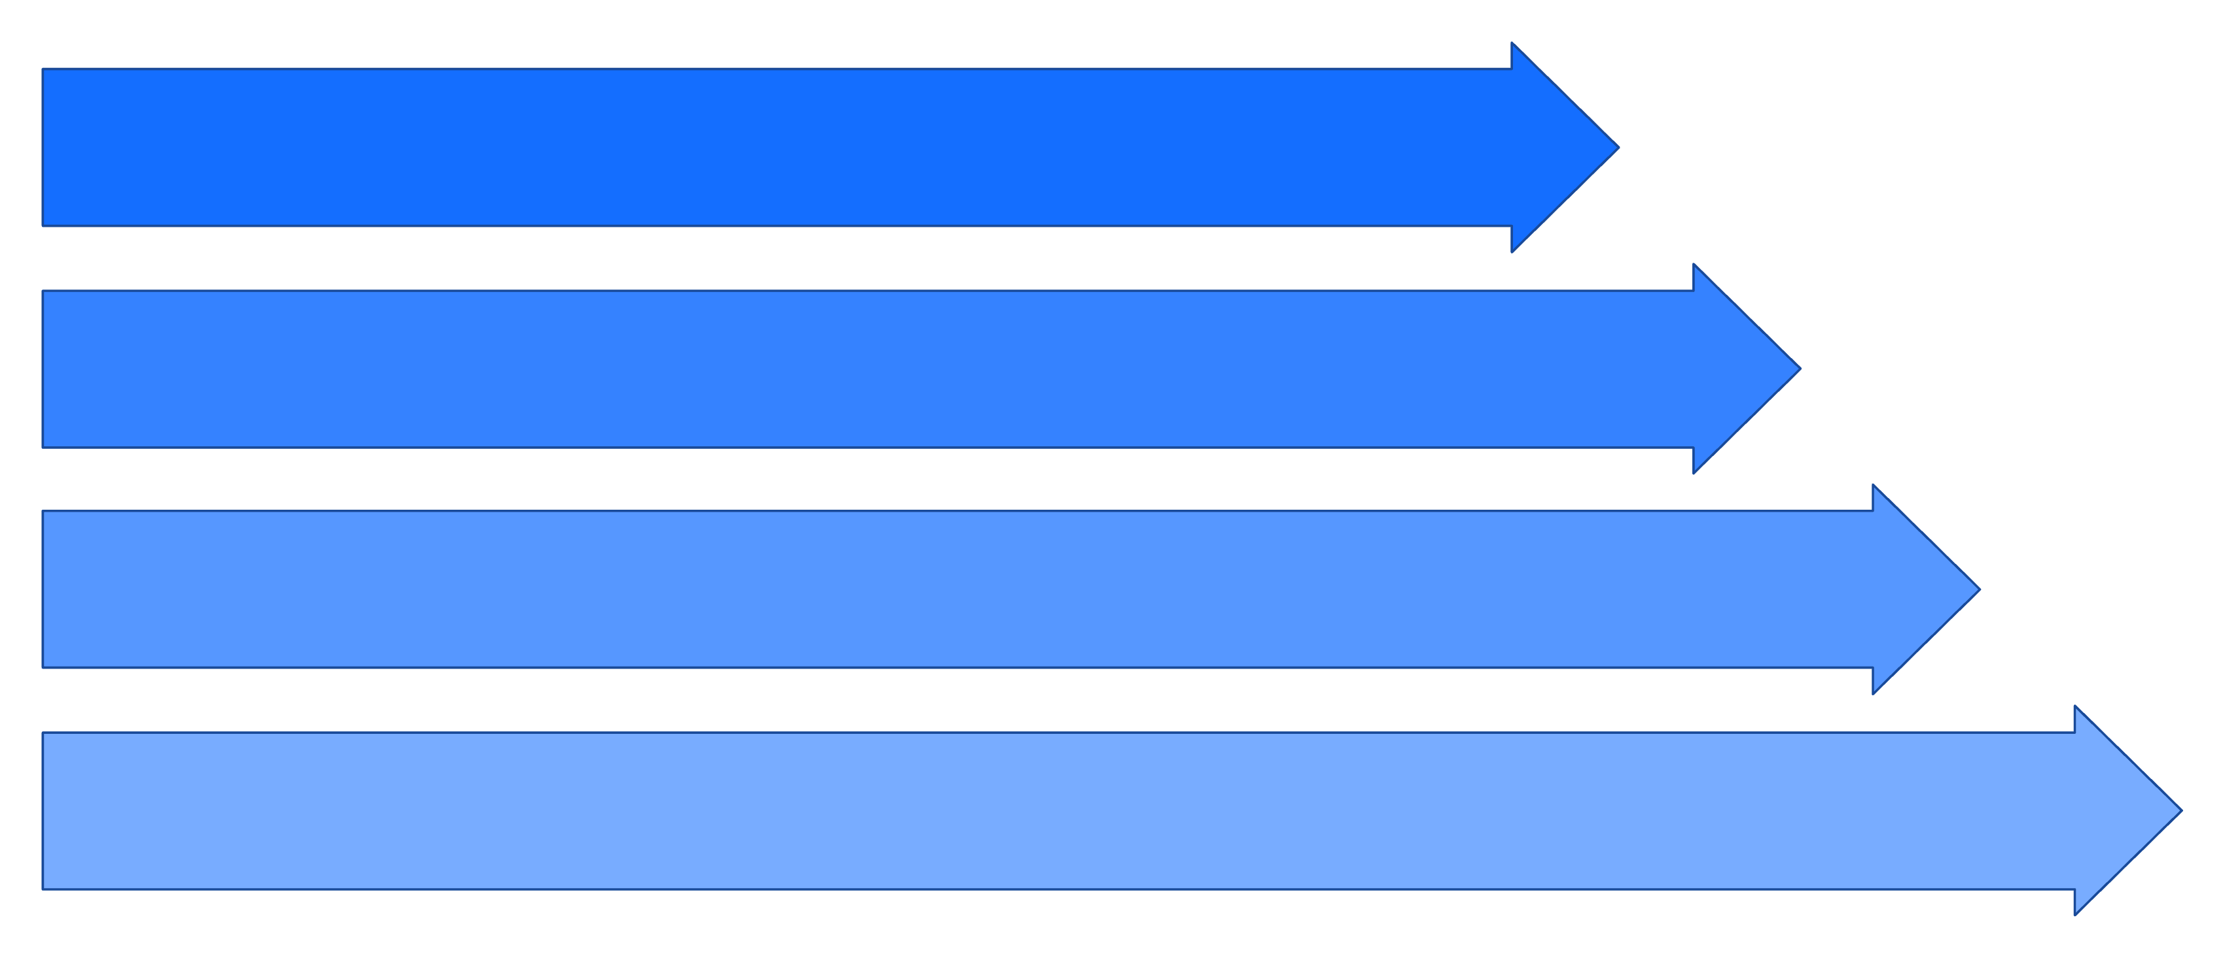
System Model: The Reconstruction Pipeline
Input
Preprocess
Orientation & Edge
Feature Match
This diagram illustrates the sequential steps taken by our system, from initial input to final reconstructed output and data persistence.

Slide 7
Detailed Pipeline Components
1
2
Orientation & Edge Search
Feature Registration
Tests 4 rotations × 4 flips for each part; compares compatible edges using a combined score (cross-correlation, pixel similarity, Canny-edge similarity); selects the best configuration.
Prioritises SIFT, with ORB as fallback. Matches via FLANN/BF with ratio test; estimates homography with RANSAC; warps second image into the first's canvas.
3
4
Fallback Stitching
Post-processing & Persistence
If feature matches are insufficient, aligns by the best edge pair, resizes along the seam direction, and feather-blends across a 50–100 px band with a non-linear alpha ramp.
Removes black borders via threshold + largest contour; applies bilateral denoise and mild sharpening. Logs all data (paths, status, methods, confidence, timestamps) into SQLite.
Visualisation of the precise alignment of two torn edges during the orientation and edge search phase.

Slide 8

Results: Visual and Quantitative Outcomes
Before & After Example
Quantitative Metrics (Example Data)
Keypoints
1250
1180
2430
points
Good Matches
-
-
187
matches
Inliers
-
-
125
points
Inlier Ratio
-
-
66.8
%
Seam Quality (SSIM)
-
-
0.92
-
Runtime
-
-
4.5
seconds
The system demonstrates robust performance, especially when sufficient texture allows homography estimation. Even with low-texture lined paper, the edge-based fallback ensures a minimally visible seam.
Input: Two torn parts of a document, requiring reconstruction.
Output: The successfully reconstructed document, showing seamless integration.

Slide 9

Conclusion & Future Work
1
2
3
Summary
Impact
Future Enhancements
Developed a robust, fully automatic pipeline for torn-image reconstruction, handling rotation, inversion, and weak texture by integrating orientation-aware edge scoring, feature-based homography, and seam-aware blending.
Useful for document recovery and serves as an excellent demonstration of registration and blending techniques in digital image processing.
Explore graph-cut/Poisson seam optimisation, exposure compensation, sub-pixel tear-curve refinement, multi-piece assembly, and development of a simple GUI.
Our work provides a practical solution with potential for further refinement.

Slide 10


References & Call to Action
Lowe, D. G. (2004). Distinctive Image Features from Scale-Invariant Keypoints.
Rublee, E., Rabaud, V., Konolige, K., & Bradski, G. (2011). ORB: An efficient alternative to SIFT or SURF.
Fischler, M. A., & Bolles, R. C. (1981). Random Sample Consensus: A Paradigm for Model Fitting with Applications to Image Analysis and Automated Cartography.
Burt, P. J., & Adelson, E. H. (1983). A Multiresolution Spline With Application To Image Mosaics.
Canny, J. (1986). A Computational Approach to Edge Detection.
Muja, M., & Lowe, D. G. (2009). Fast Approximate Nearest Neighbours with Automatic Algorithm Configuration.
Watch a short demo of our system in action and access the code repository to explore the implementation details. We welcome feedback and collaboration!

